Slide 1
Variational Entity Deduplication

Slide 2
Problem Statement
Improving Entity matching using variational attributes
Variational attributes: tokens that characterize two entities that are variations of each other
To do this, we mine domain-dependent variational attributes present in unstructured text
Eg:
“TabMaker Color HD 16 GB”
“TabMaker Color HD 8 GB”
The above two entities are variational because of their storage size
They have same base attributes

Slide 3
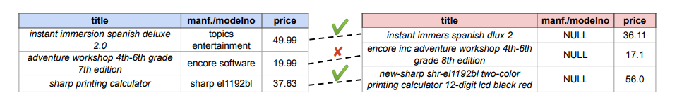
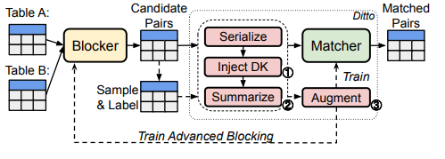
Deep entity matching with Pre-trained Language models [VLDB’20]
DITTO is a BERT based model to entity matching
This is a 2-class classification problem
Duplicate
Distinct

Slide 4
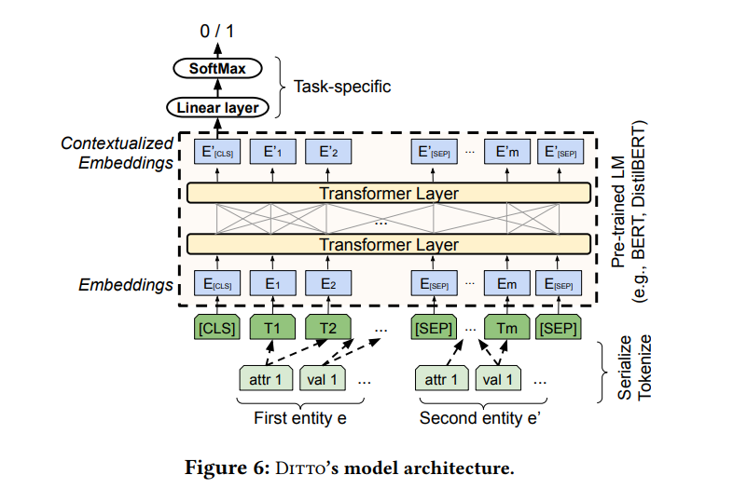
DITTO Architecture

Slide 5
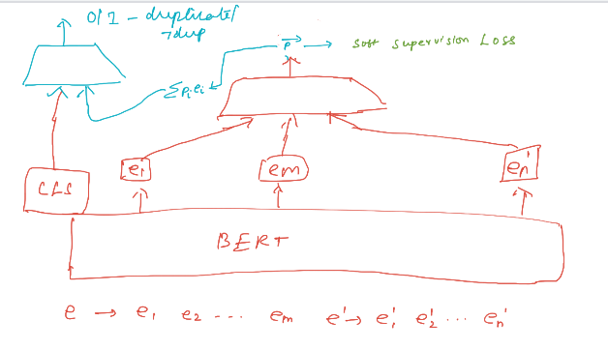
Proposed Approach
FF
FF

Slide 6
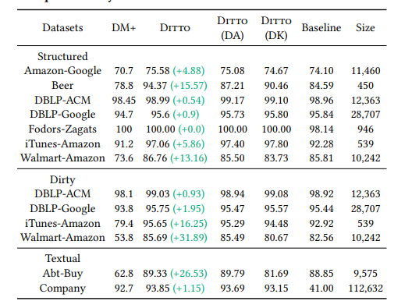
Datasets

Slide 7
Initial Results
Baseline
Proposed Approach
=========eval at epoch=20=========
Validation:
====Structured/Walmart-Amazon====
accuracy=0.964
precision=0.815
recall=0.798
f1=0.806
======================================
Test:
====Structured/Walmart-Amazon====
accuracy=0.962
precision=0.812
recall=0.782
f1=0.797
======================================
=========eval at epoch=20=========
Validation:
====Structured/Walmart-Amazon====
accuracy=0.965
precision=0.820
recall=0.803
f1=0.812
======================================
Test:
====Structured/Walmart-Amazon====
accuracy=0.963
precision=0.821
recall=0.782
f1=0.801
======================================

Slide 8
End Sem Presentation

Slide 9
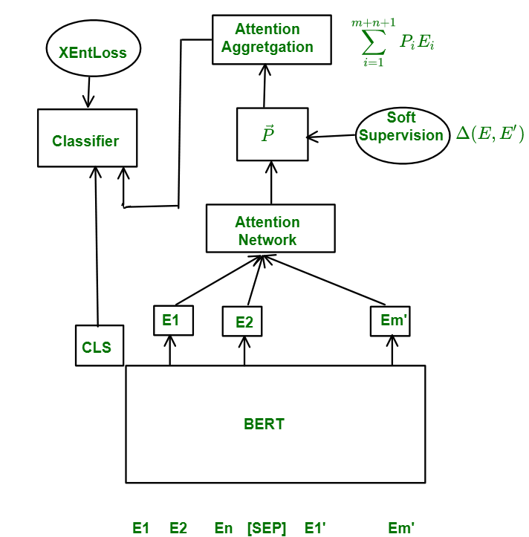
Block Diagram

Slide 10
Block Diagram
We worked only with Walmart-Amazon Dataset

Slide 11
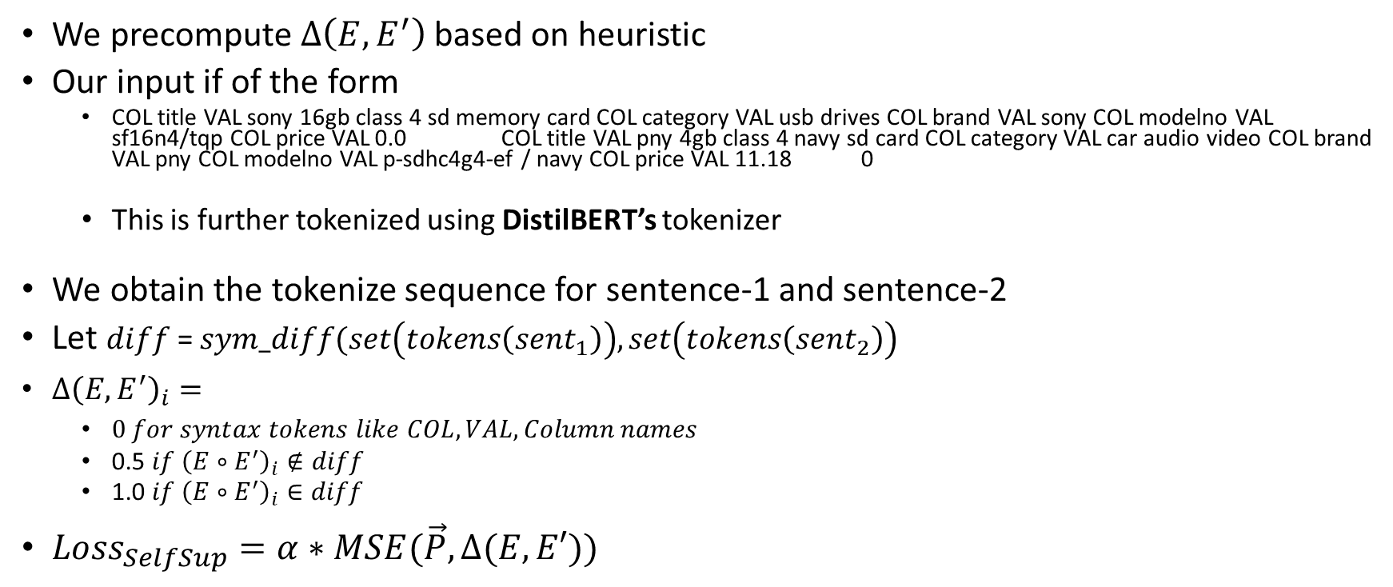
Details on soft-supervision
We precompute $Δ\left(E, E^{′}\right)$ based on heuristic
Our input if of the form
COL title VAL sony 16gb class 4 sd memory card COL category VAL usb drives COL brand VAL sony COL modelno VAL sf16n4/tqp COL price VAL 0.0 COL title VAL pny 4gb class 4 navy sd card COL category VAL car audio video COL brand VAL pny COL modelno VAL p-sdhc4g4-ef / navy COL price VAL 11.18 0
This is further tokenized using DistilBERT’s tokenizer
We obtain the tokenize sequence for sentence-1 and sentence-2
Let $diff$= $sym_diff(set\left(tokens\left(sent_{1}\right)\right), set\left(tokens\left(sent_{2}\right)\right)$
$Δ{\left(E, E^{′}\right)}_{i}=$
$0 for syntax tokens like COL, VAL, Column names$
0.5 $if {\left(E∘E^{′}\right)}_{i}∉diff$
1.0 $if {\left(E∘E^{′}\right)}_{i}∈diff$
$Loss_{SelfSup}=α∗MSE(\vec{P}, Δ(E, E′))$

Slide 12
Baseline Results [Done]

Slide 13
Results with attention (no soft supervision) without Augmentation [Done]

Slide 14
Results with attention (no soft supervision) With Augmentation (Lokesh)
Commit Msg : Adding variational attention with Augmentation without self supervision

Slide 15
Results with attention (soft supervision) (Best Alpha)

Slide 16

Sensitivity of $α$ [0.1, 0.5, 1, 0.01, 0.001]

Slide 17
Ditch attn, and aggregate based of y_self_sup [Lokesh]
Relate this expt to alpha valye

Slide 18
Conclusion
We think we would have obtained more meaningful results if we were able to enforce soft supervision from some king of ground truth rather than the naïve heuristics that we adopted in this paper.

Slide 19
References
Varun Embar, Bunyamin Sisman, Hao Wei, Xin Luna Dong, Christos Faloutsos, and Lise Getoor. 2020. Contrastive Entity Linkage: Mining Variational Attributes from Large Catalogs for Entity Linkage. In Automated Knowledge Base Construction. https://doi.org/10.24432/C5W88R

